Slide 1

Lab 9 : UI / UX Design
IT - 314
Software Engineering
TAs :
Pinak Gajera
Dhara Mehta
Course Instructor :
Prof. Jayprakash Lalchandani

Slide 2
Outline
UI Design - What / Why.
UX Design - What / Why.
UI design vs UX design.
Basic Principles.
Characteristics of good UI.
Common mistakes in UI design.
Significance of UI design in web apps and Android apps.
Customer Approval before implementation.
How UI / UX has become a very vital part of software projects.

Slide 3
User Interface Design - What & Why ?
The design of user interfaces for machines and software, such as computers, home appliances, mobile devices, and other electronic devices, with the focus on maximizing usability and the user experience.
The aim is to make the user’s interaction as simple and efficient as possible, in terms of accomplishing user goals ..
Make a better experience for users when navigating through your app, platform or website.
It focuses on all the visual and interactive elements of a product interface, such as buttons, menu bars, icons, and more.
Wikipedia

Slide 4
User Experience Design - What & Why ?
User experience design is the process of enhancing user satisfaction with a product by improving the usability, accessibility, and pleasure provided in the interaction with the product.
User experience design encompasses traditional human - computer interaction (HCI) design, and extends it by addressing all aspects of a product or service as perceived by users.
Make a better experience for users by understanding their behavior and how they interact with a product or a software.
It focuses on the user journey and how efficient and easy to use the product is.
Wikipedia

Slide 5
UX UI
UX is how it works and feels
UX design is what makes an interface useful
UI is how it looks
UI design is what makes an interface beautiful

Slide 6
Basic Principles
1. Meet the users’ needs.
2. Know where you are in the design process.
3. Have a clear hierarchy.
4. Keep it consistent.
5. Understand accessibility.
6. Context is key.
7. Usability first.
8. Use simple language.
9. Typography is powerful.
10. Feedback matters.

Slide 7
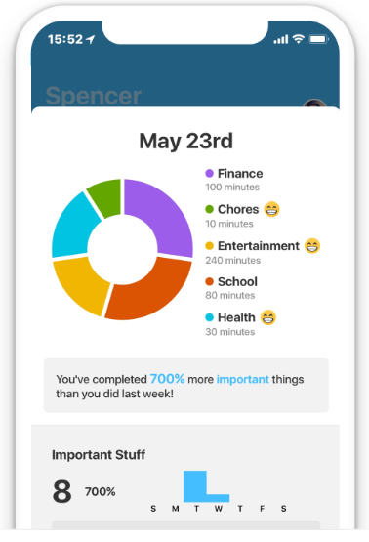
Characteristics of Good UI
Clear and Simple :
The whole purpose of user interface design is to enable the user to interact with your system by communicating meaning and function.
Make sure the interface is understandable and simple to navigate through
For example, The design has all information that looks simple & interactive.

Slide 8
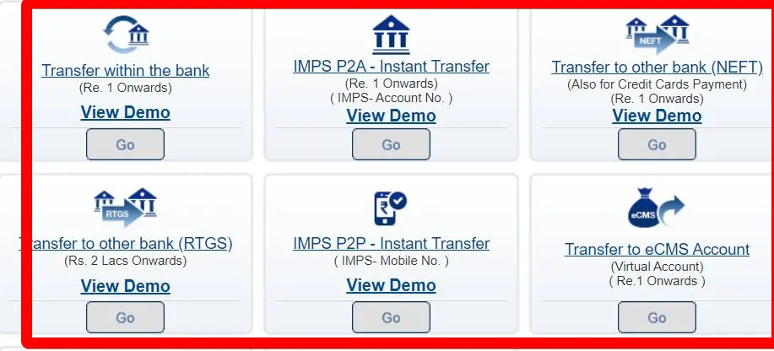
Characteristics of Good UI
Intuitive and consistent :
The design process should be based on the logic of usability -features that are the most frequently used should be the most prominent in the UI and controls should be made consistent so that users know how to repeat their action.
For example, For regular users of online net banking websites or apps, the often changes in icons or labels may occur mistakes in the transaction & which is not suitable for the bank.
These categories of HDFC bank transfer features have been unchanged & consistent for a long time.

Slide 9
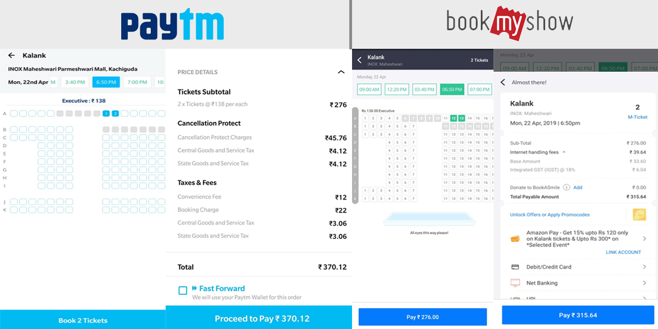
Characteristics of Good UI
Responsive :
If the interface fails to keep up with the demands of the user, this will significantly diminish their experience and can result in frustration, particularly when trying to perform basic tasks.
For Example, The seats must be updated with the seconds in BookMyShow, PayTM or any booking platforms.

Slide 10
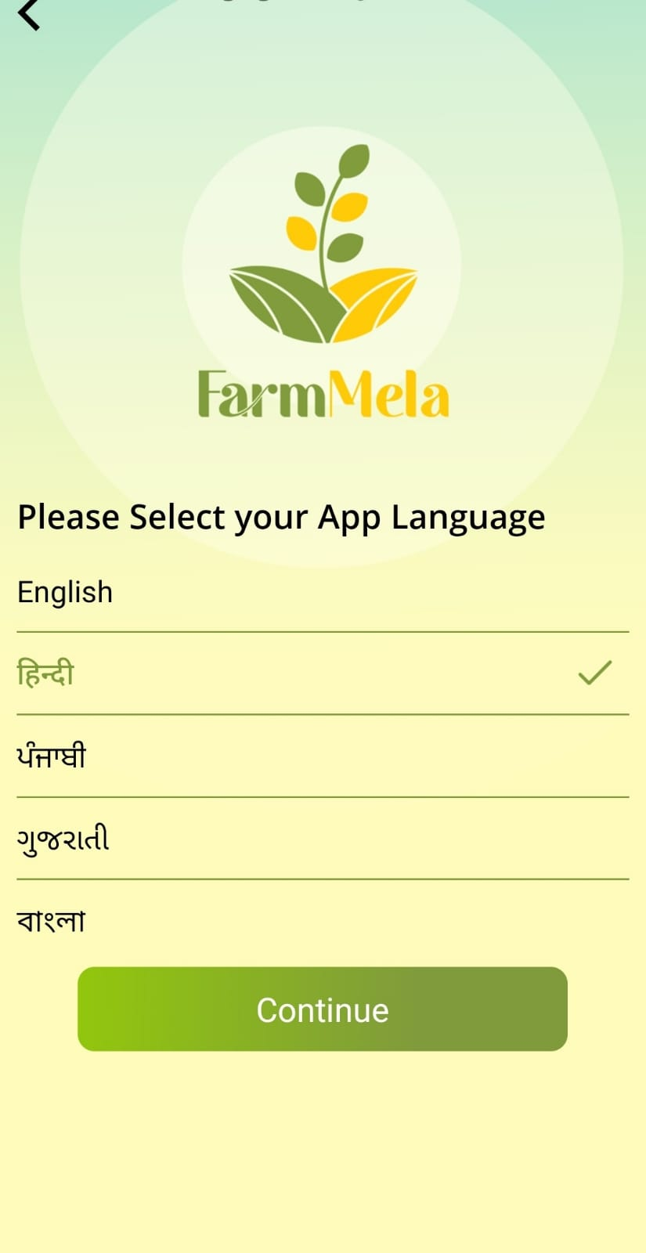
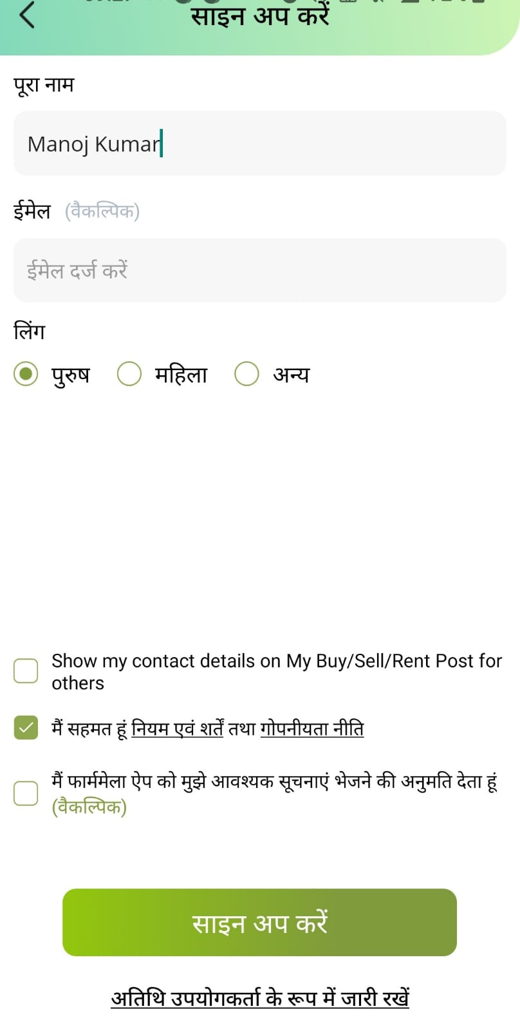
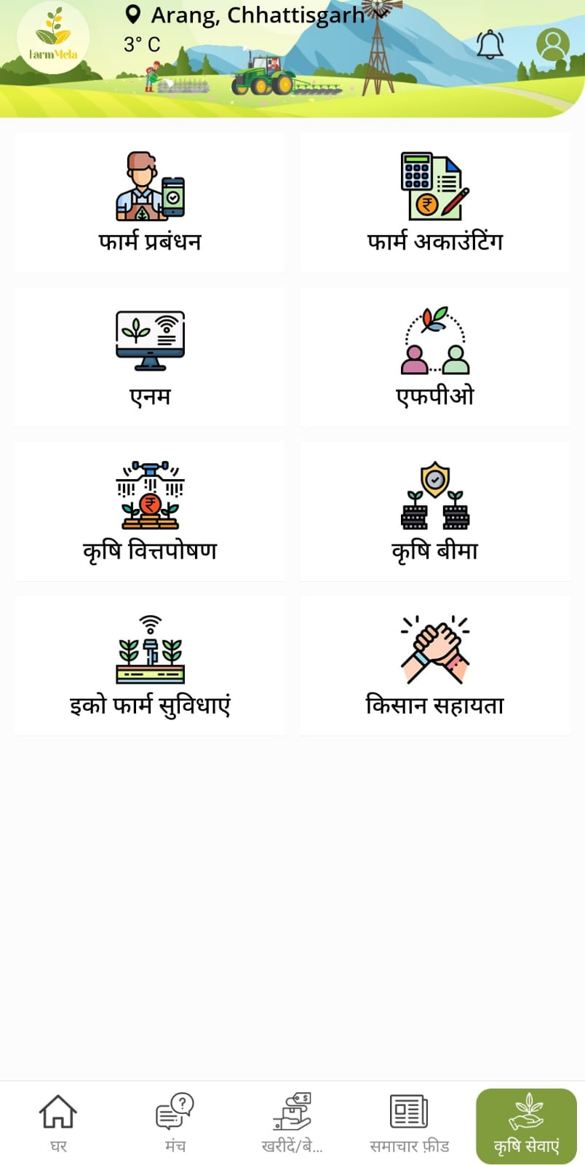
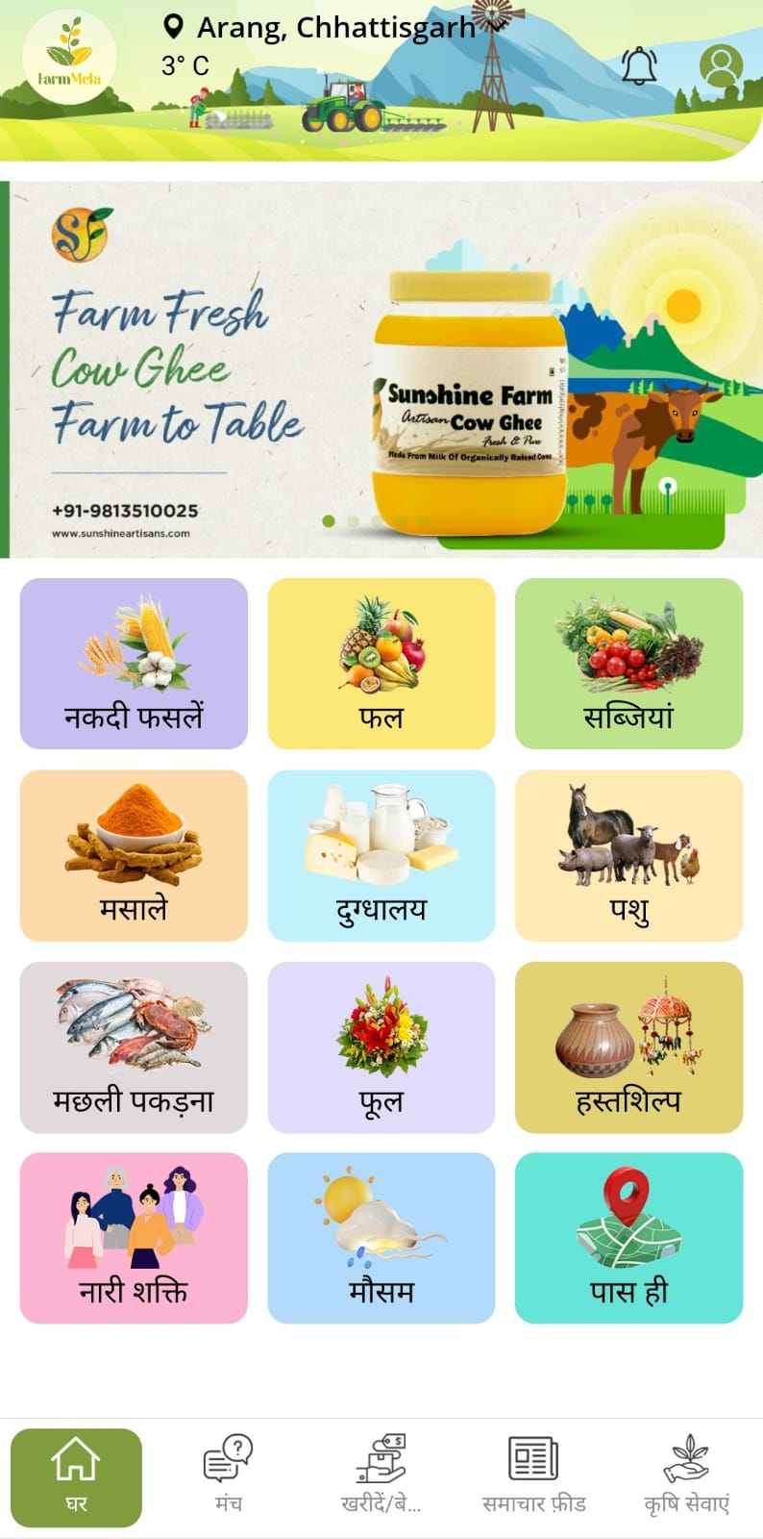
Creative but familiar :
When the users are familiar with something and know how it behaves, navigation becomes easier. In effect, the user expects to see what is familiar to him or her.
Example, In FarmMela app farmer/any user can select his/her own local language to use the app. And can perform functioning in that language itself.

Slide 11
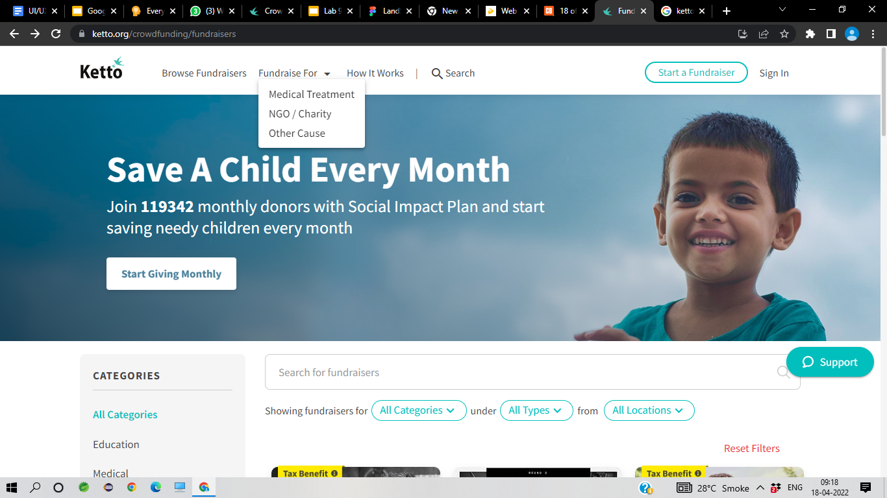
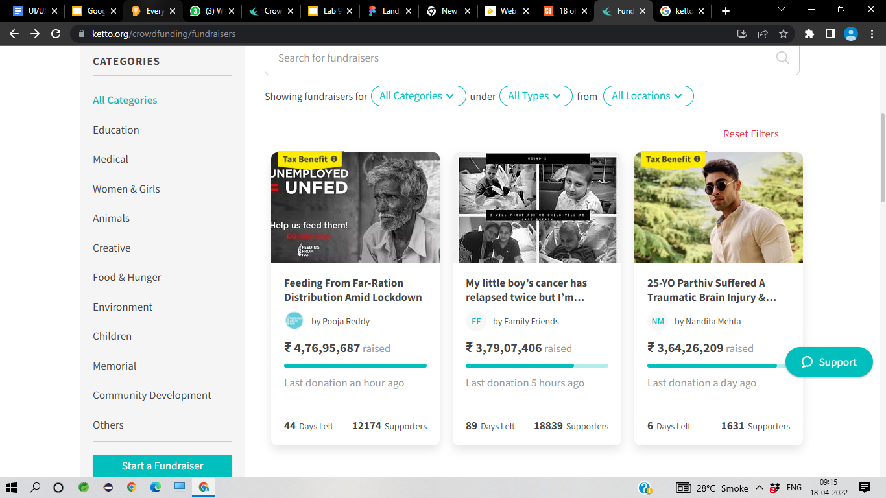
Maintainable :
A UI should have the capacity for and changes to be integrated without causing a conflict of interest.
For Example, In ketto how many people are donating funds to which of the fundraiser or to which category they are donating needs to get maintain.

Slide 12
Common Mistakes in UI Design
Unresponsive Design
Unintuitive Navigation
Generic Imagery
Too Much Text
Slow Page Loading Speed
Making the User Think
Designing for Yourself

Slide 13
Significance of UI design in web apps & Android apps
Retain Uniformity
Use a Simple Design
Provide Fast Loading Speed
Use Standard Elements
Make it More Interactive
Use Large Formats and Visuals
Use High-resolution Images
Use Few Fonts
Focus on your Intended Audience
Include Feedback and Response Time
Provide User Assistance and Help

Slide 14
Customer Approval before Implementation
In any Industry, work often needs to be formally approved before it can begin.
Budgets, creative projects, marketing initiatives, invoices, and many other work items all move through a series of approvals before they are considered either ready for kickoff or complete.
Some functionalities for Approval Process are Create Discrete Steps, Customization, Edit Capabilities, Mobile Features, Feedback Collection.
Some Questions related to Approval Process are :
How should requests be submitted?
What documentation should you include?
Who approves this particular step of the process?
Under what criteria should requests be automatically approved or rejected?
What actions happen when a request is approved or rejected?

Slide 15
How UI/UX has become very vital part of Software Projects
A team without a UI/UX Designer it is like a product without a sale. One plays a very important role in the project, makes sure that you can meet the client’s preferences more effectively.
The primary goal of any business is to increase its sales and increase the growth of the business. UX/UI Design plays an essential role in achieving this goal.
The UX/UI Design of the application improves the user experience and customer satisfaction that ultimately helps increase the number of users of the specific application.
The number of consumers you are getting on your website / application can measure the success of the great UI and UX.

Slide 16
References
https://en.wikipedia.org/wiki/User_interface_design
https://en.wikipedia.org/wiki/User_experience_design
https://www.springboard.com/blog/design/
https://www.crazyegg.com/blog/
https://www.smartsheet.com
https://medium.com

Slide 17
Thank You :)

